Slide 1
Theological and Biblical Basis for Peacebuilding
CKU / Danish Mission Council
Dr. Peter Sensenig

Slide 2
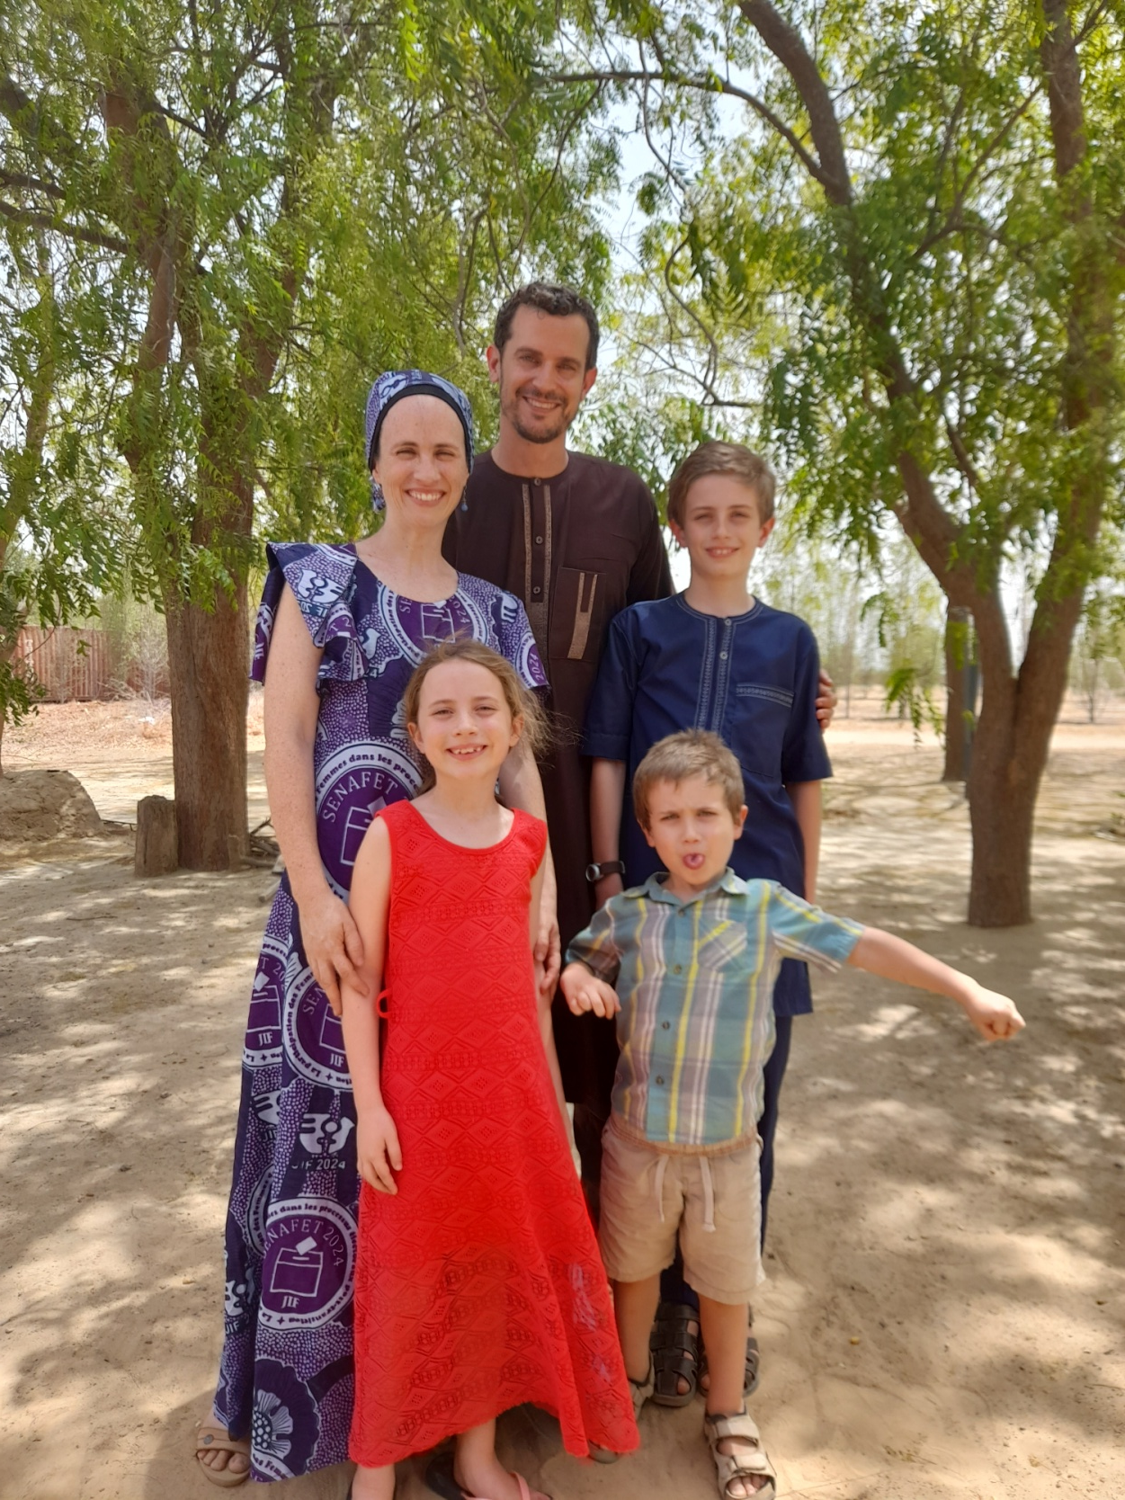

Slide 3
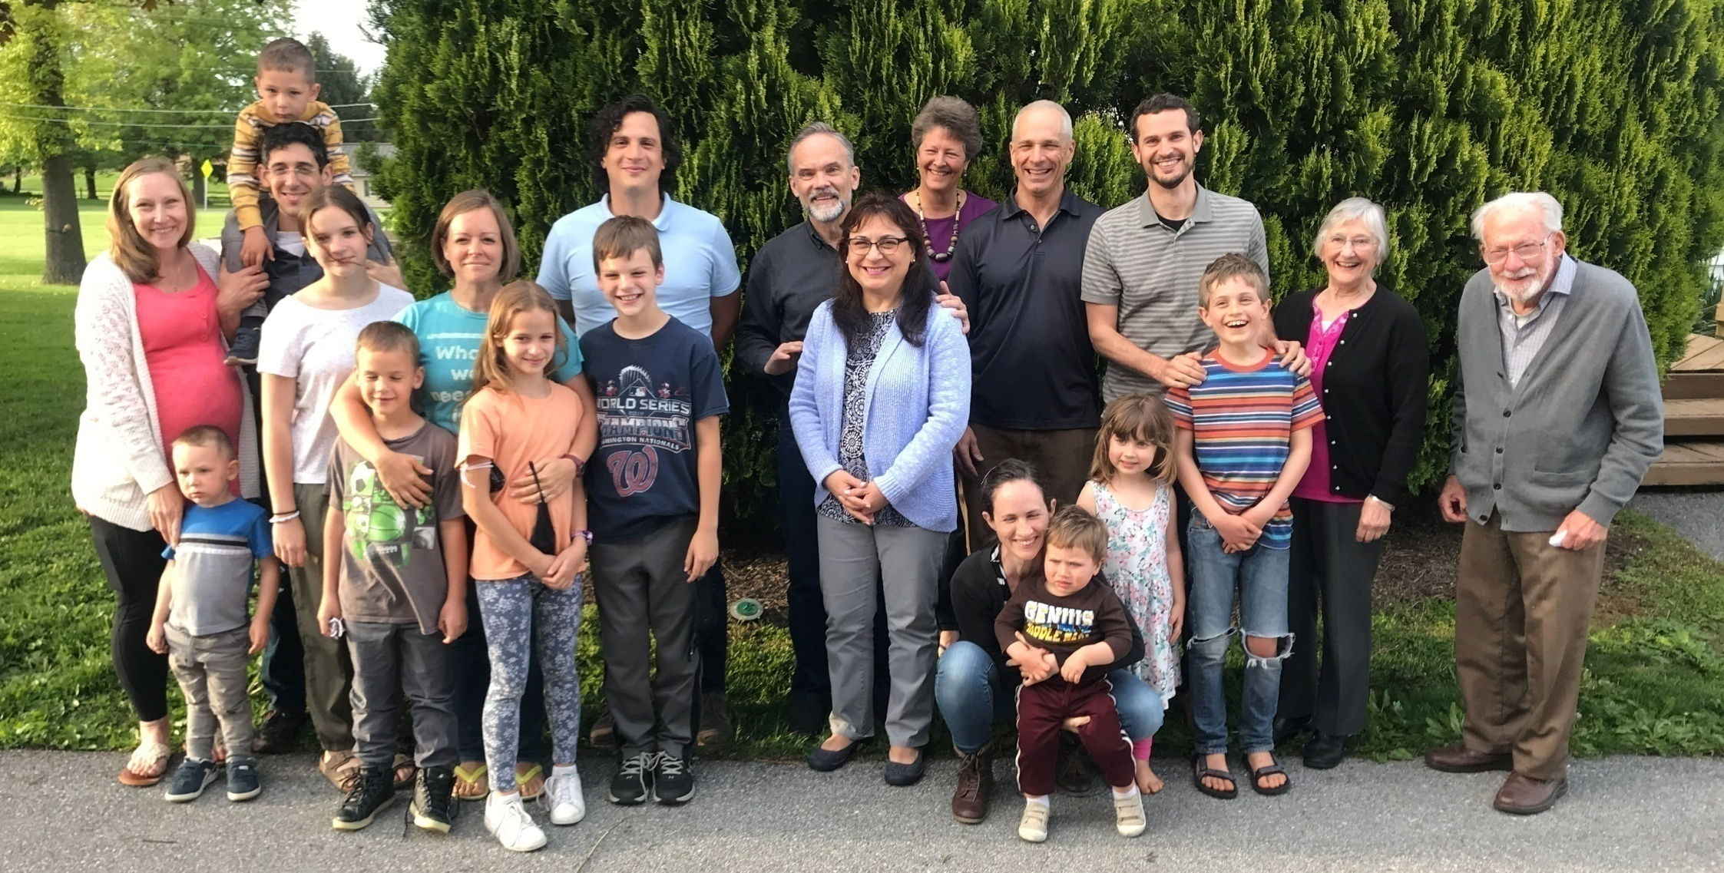

Slide 4
Negative peace (from…) | Positive peace (for…)
1) war | concord between governments
2) harassment, degradation | order in society, mutual esteem, creation care
3) resentment and quarrels | harmony
4) mental or emotional distress | serenity of spirit
5) sin against God | reconciliation with God
Adapted from David Barash and Charles Webel, Peace and Conflict Studies, 5th ed., (New York: Sage, 2021), 4-5.

Slide 5
1

Slide 6
2

Slide 7
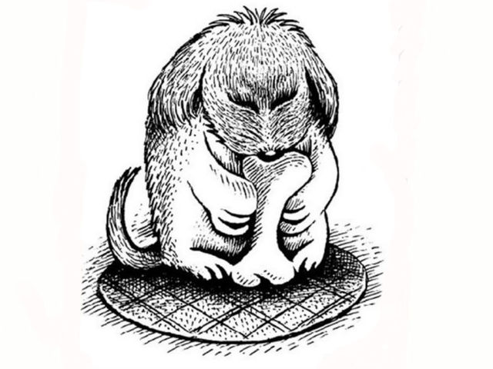

Slide 9
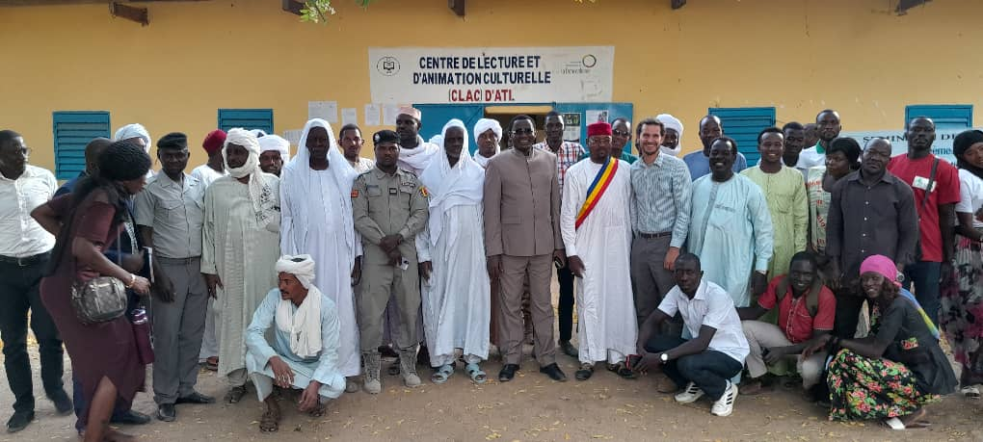
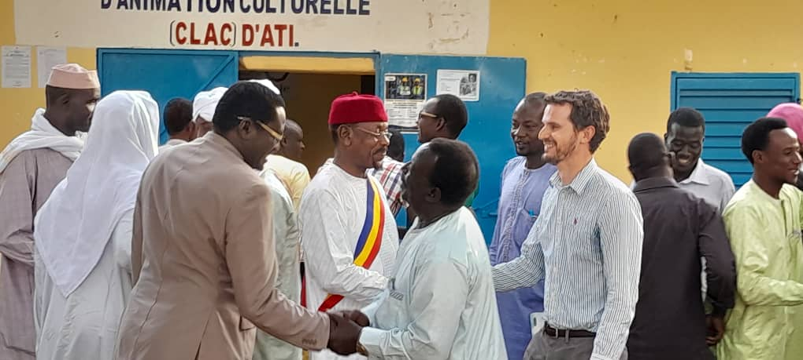

Slide 10
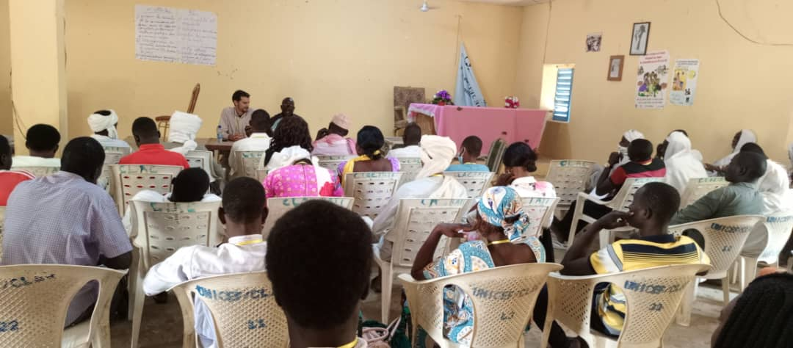
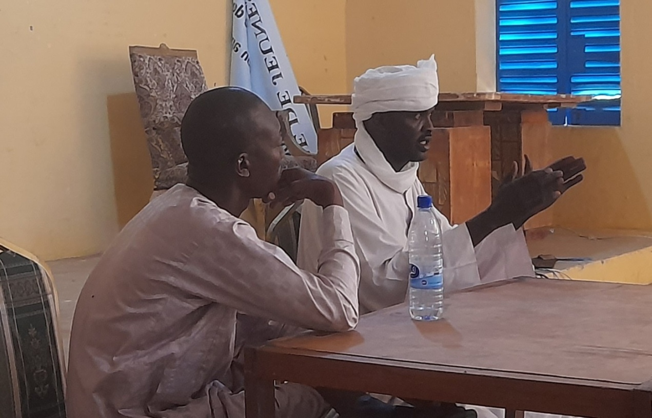

Slide 11
Peacebuilding Text: Sermon on the Plain
I say to you that listen, Love your enemies, do good to those who hate you, bless those who curse you, pray for those who abuse you.
If anyone strikes you on the cheek, offer the other also; and from anyone who takes away your coat do not withhold even your shirt.
Give to everyone who begs from you; and if anyone takes away your goods, do not ask for them again.
Do to others as you would have them do to you.
- Luke 6:27-36

Slide 12
Peacebuilding Text: Sermon on the Plain
If you love those who love you, what credit is that to you? For even sinners love those who love them.
If you do good to those who do good to you, what credit is that to you? For even sinners do the same.
If you lend to those from whom you hope to receive, what credit is that to you? Even sinners lend to sinners, to receive as much again.
But love your enemies, do good, and lend, expecting nothing in return. Your reward will be great, and you will be children of the Most High; for he is kind to the ungrateful and the wicked.
Be merciful, just as your Father is merciful.
- Luke 6:27-36

Slide 13
Peace in Paul
Rom. 5:10: “While we were enemies we were reconciled to God by the death of his son.”
Col. 1:15, 19-20: “Image of the invisible God in whom all the fullness of God was pleased to dwell…making peace by the blood of the cross.”
Eph. 2:13-18: cross has “broken down the dividing wall of hostility.”
Rom. 12:14-21: “Overcome evil with good.”

Slide 14
Peace in Pastoral Epistles and Revelation
Jam. 4:4; 3:17-18: war is “friendship with the world” and “enmity with God”;
“The harvest of righteousness is sown in peace by those who make peace.”
1 Pet. 3:10-11: Follow example of Christ:
“He who would love life and see good days…let him seek peace and pursue it.”
Rev. 1:16; 12:11: Lamb that was slain – “sharp sword of his mouth”;
People of God conquer “by the blood of the Lamb and the word of their testimony.”

Slide 15
Jesus and Samaritans
Samaritan woman at the well (John 4)
Parable of the Good Samaritan (Luke 10)
Samaritans as mission field (Acts 1)
Only Samaritan thanks Jesus for healing (Luke 17)
Samaritans oppose Jesus (Luke 9:51-56)

Slide 16
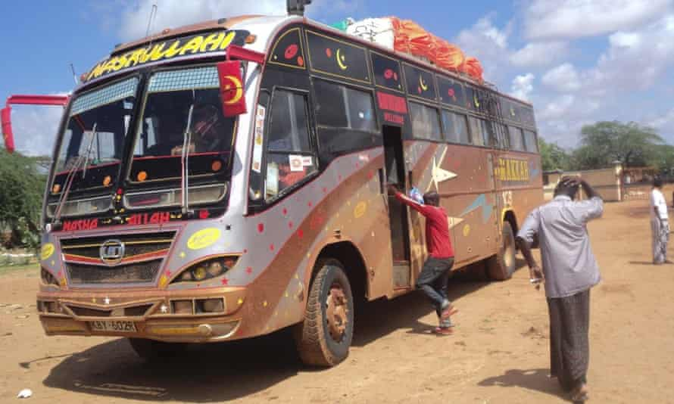
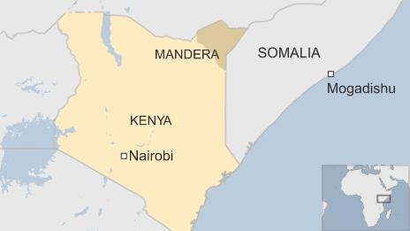

Slide 17
Resources
David Buttrick, Speaking Conflict: Stories of a Controversial Jesus (2007).
Richard B. Hays, “Violence,” in The Moral Vision of the New Testament (1996).
John Paul Lederach, The Journey toward Reconciliation (1999).
Ken Sande, The Peacemaker: A Biblical Guide to Resolving Personal Conflict (2004).
Peter Sensenig, “Biblical Ethics of Peacemaking” (2024).
Walter Wink, Engaging the Powers: Discernment and Resistance in a World of Dominations (1992).

