Slide 1
Values and Skills for Peacebuilding
CKU / Danish Mission Council
Dr. Peter Sensenig

Slide 2
Moral Imagination
CURRENT
STATE
-[attitudes]
-[relationships]
-[economic and social structures]
IMAGINED FUTURE
-[attitudes]
-[relationships]
-[economic and social structures]

Slide 3
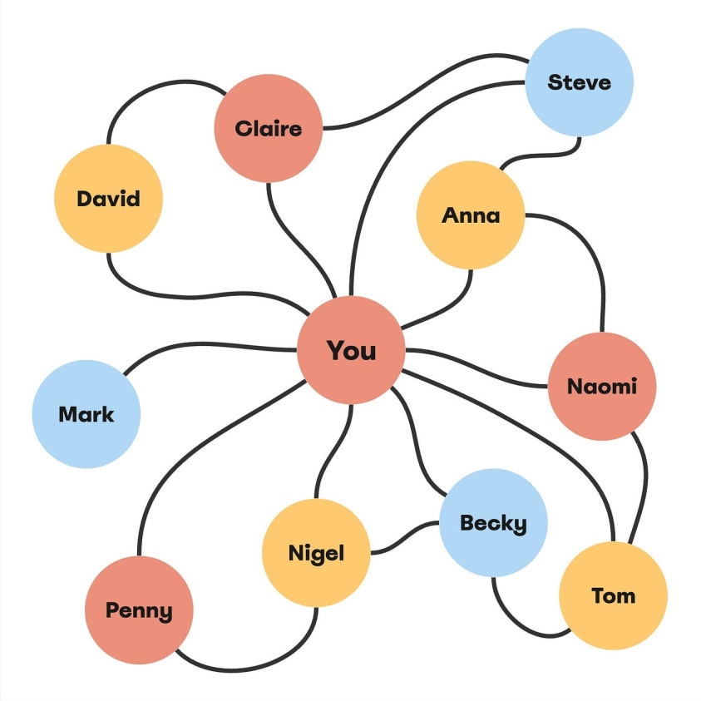
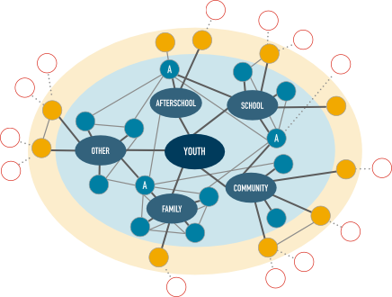
Moral Imagination

Slide 4
Moral Imagination
CURRENT
STATE
of enmity
IMAGINED FUTURE
(with enemies included)
https://www.jewishvoiceforpeace.org/resource/our-vision/

Slide 6
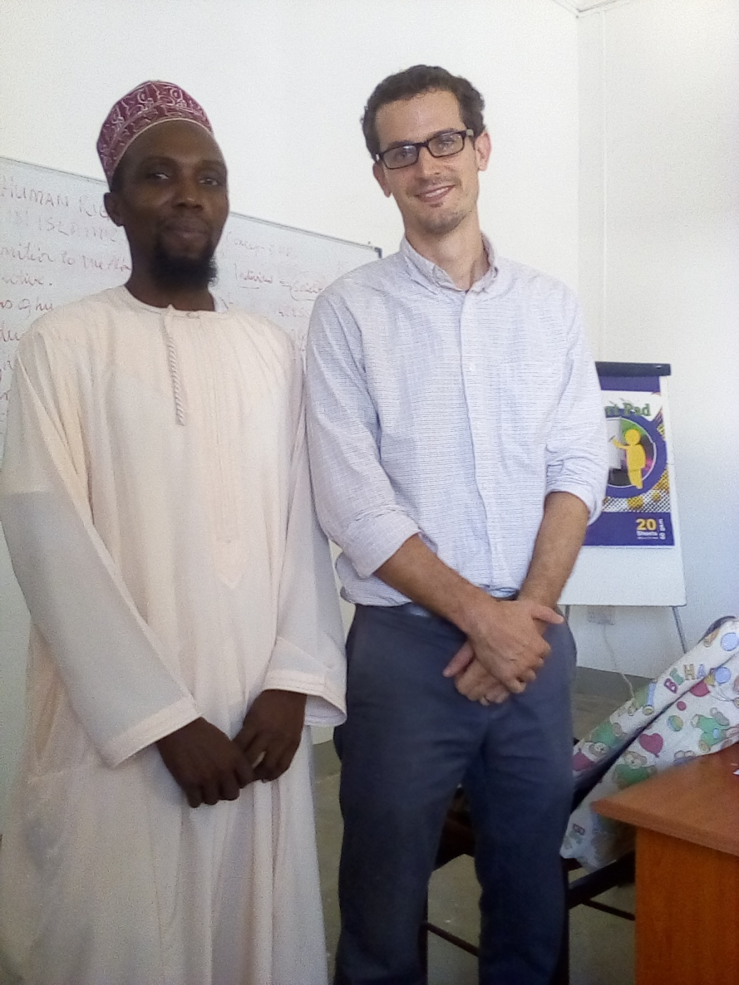
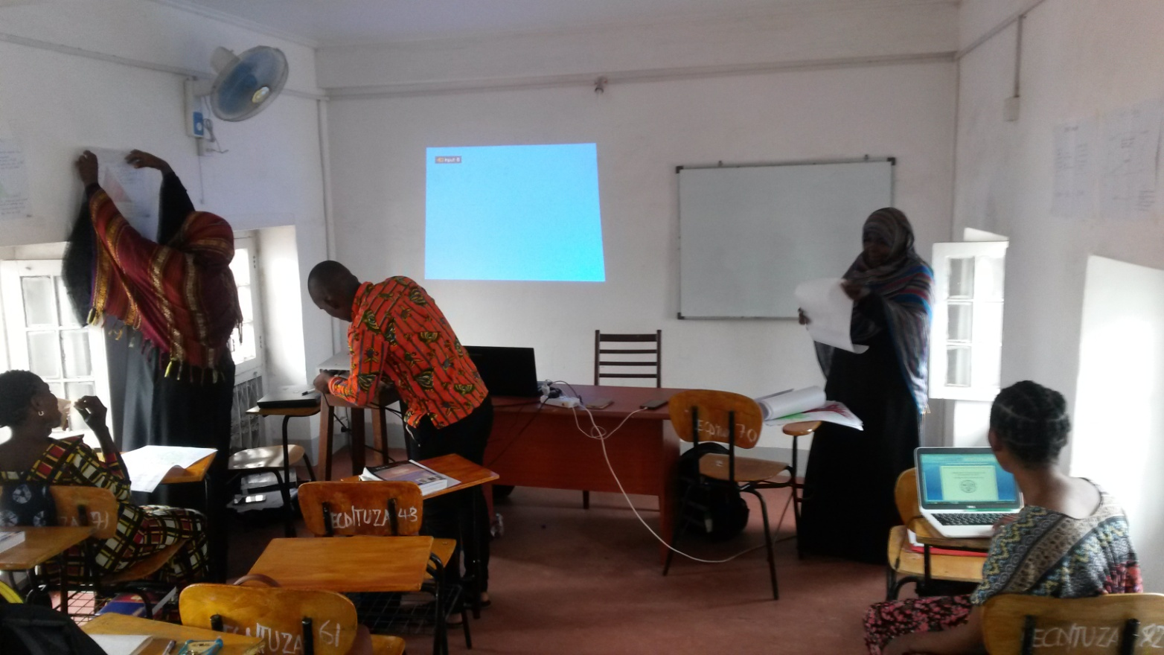
Zanzibar Interfaith Centre (ZANZIC)

Slide 7
Moral Imagination
CURRENT
STATE
-[attitudes]
-[relationships]
-[economic and social structures]
IMAGINED FUTURE
-[attitudes]
-[relationships]
-[economic and social structures]
Approach #1
Approach #2
(conflict analysis)
(plan)
(best outcome)

Slide 8
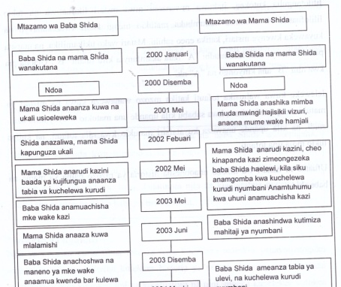
Conflict Timeline

Slide 9
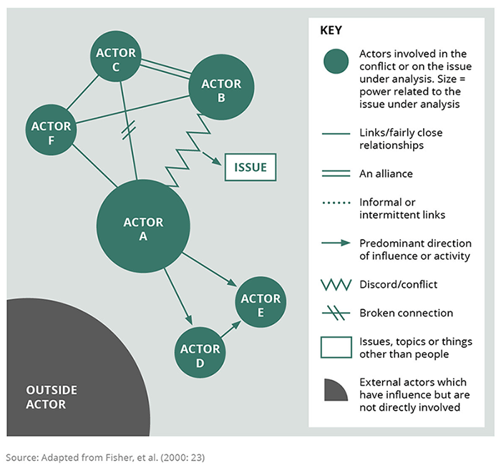
Conflict Mapping

Slide 10
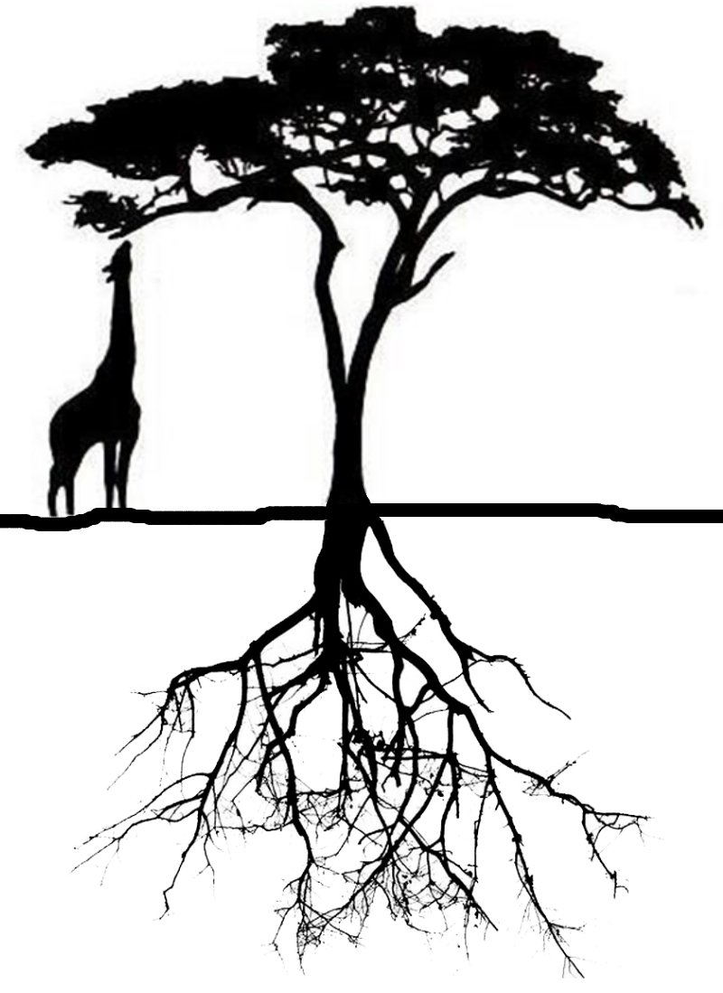
Tree of conflict-peace
Outcomes
(leaves/fruit)
Actions/behaviors
(trunk)
Beneficiaries of outcomes
Context
(soil)
Attitudes
(roots)
Jon Rudy, www.PeaceBuildingGlobal.com
Notes:
Impacts – the displacement, destruction, destitute
Actions/behaviors – all kinds of violence

Slide 11
Values: Human needs and human rights
Material needs and rights
Food, shelter, water, healthcare, resources
Economic justice
Social needs and rights
Dignity, belonging
Security
Decision-making
Civil and political rights
Education
Cultural needs and rights
Meaning and purpose in life
Religious freedom and minority rights
Lisa Schirch, Little Book of Strategic Peacebuilding (Intercourse: Good, 2004), 13-15.

Slide 12
Values for Peacebuilding
Interdependence
Partnership
Power with rather than power over
Limiting violence
Nonviolent options
Justice and peace
Human security

Slide 13
Relational Skills for Peacebuilding
Self-reflection
Active listening
Diplomatic and assertive speaking
Appreciative inquiry
Creative problem-solving
Dialogue
Negotiation
Mediation
Schirch, Strategic Peacebuilding, 18-20.

Slide 14
Group discussion
What conflict would you choose?
What values are behind your choice?
What relational skills are most important in transforming the conflict?

Slide 15
Resources
Lisa Schirch, Little Book of Strategic Peacebuilding (2004).
John Paul Lederach, The Moral Imagination: The Art and Soul of Building Peace (2005).
Ronald J. Sider, Nonviolent Action (2016).
Michelle E. Armster and Lorraine Stutzman Amstutz, eds., Conflict Transformation and Restorative Justice Manual: Foundations and Skills for Mediation and Facilitation (2008).

