Slide 1
Multi-faith Peacebuilding
CKU / Danish Mission Council
Dr. Peter Sensenig

Slide 2
In your hearts set apart Christ as Lord.
Always be prepared to give an answer to everyone who asks you to give the reason for the hope that you have.
But do this with gentleness and respect.
1 Peter 3:15

Slide 3
Principles and Practices for Gentleness and Respect (1 Peter 3:15)
Understanding other / self
Proclamation
Martin Accad: SEKAP Scale
Apologetic
Polemic
Existentialist
Kerygmatic
Syncretistic
Martin Accad, Sacred Misinterpretation: Reaching Across the Christian-Muslim Divide (Grand Rapids: Eerdmans, 2019), 7-20.

Slide 4
Principles and Practices for Gentleness and Respect (1 Peter 3:15)
Understanding other / self
Kerygma (proclamation)
Winning?

Slide 5
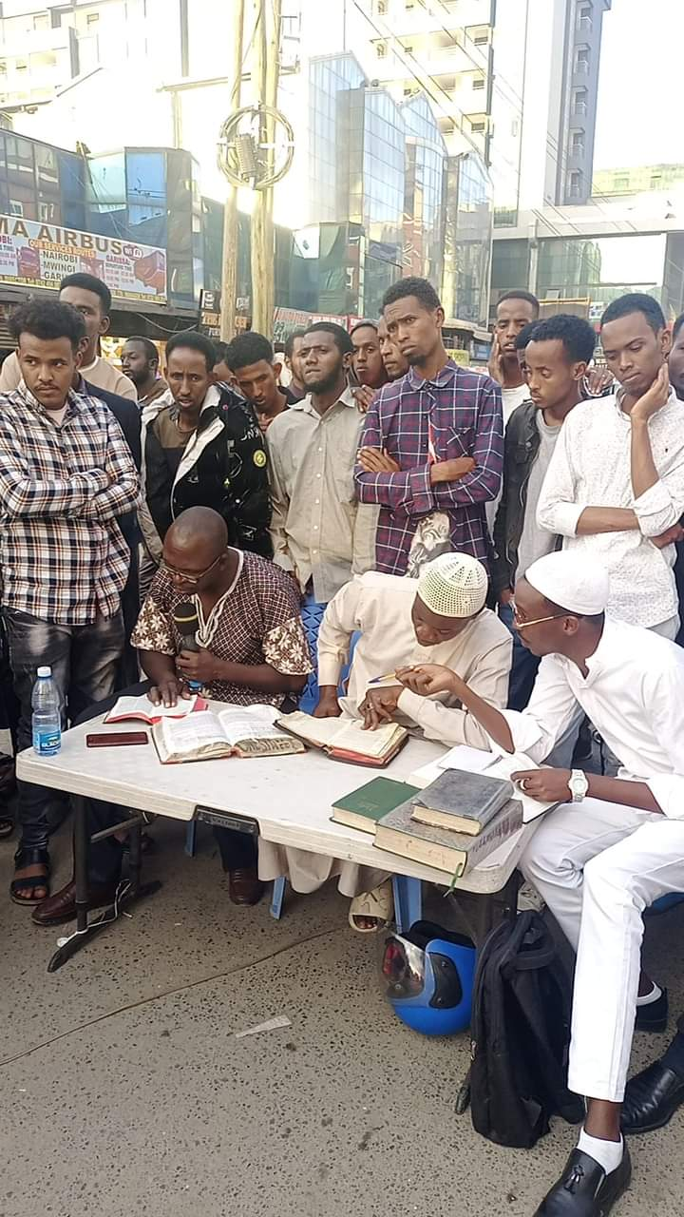
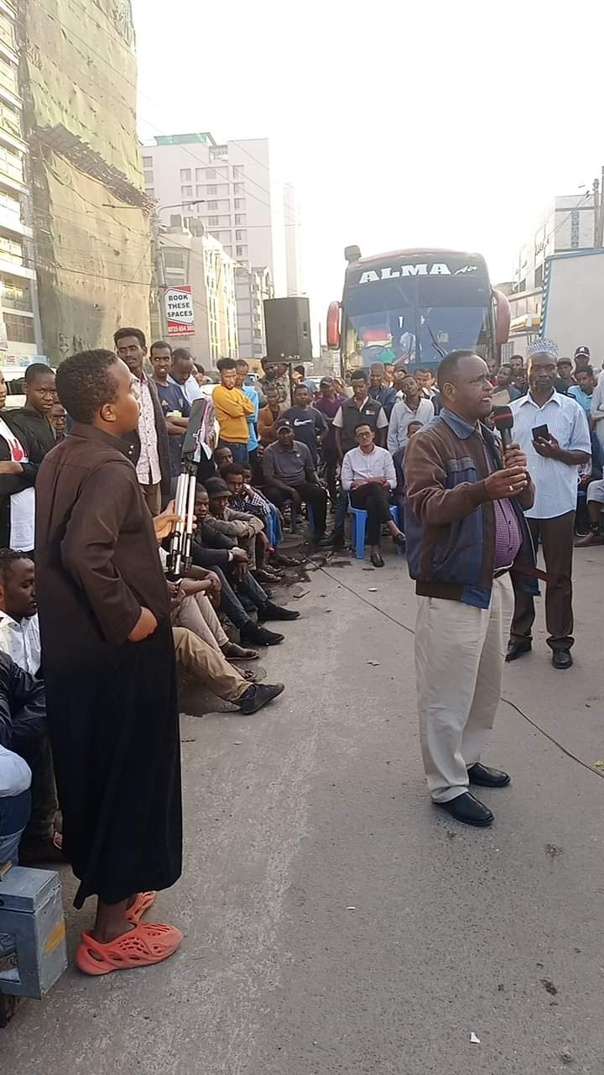

Slide 6
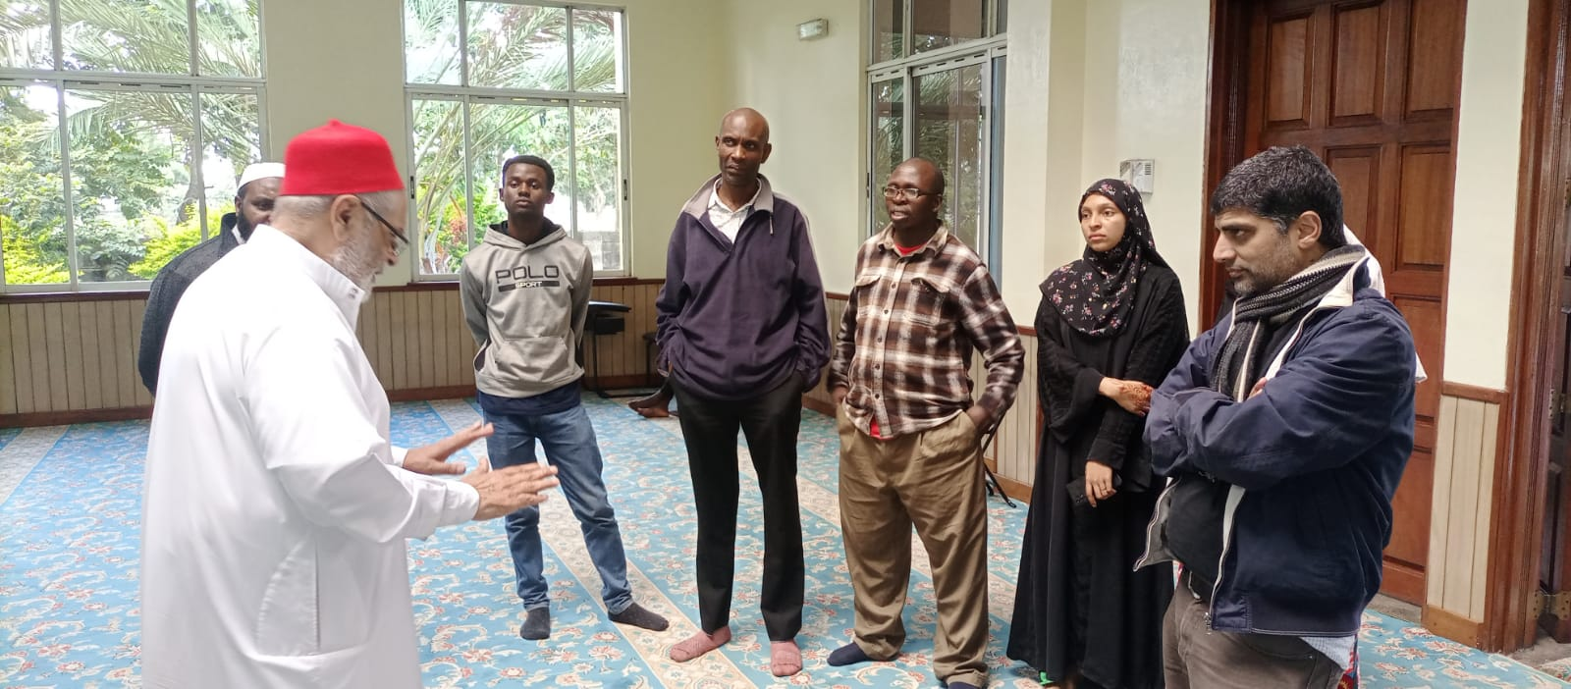
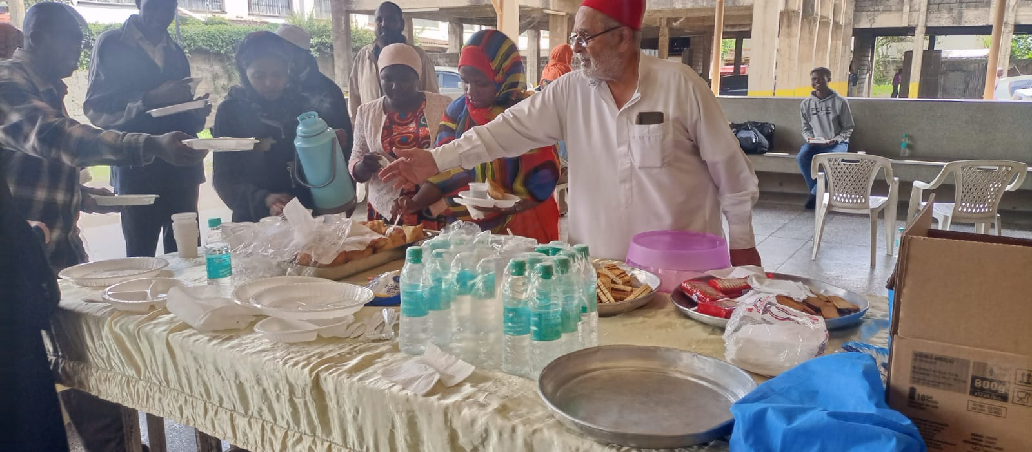

Slide 7
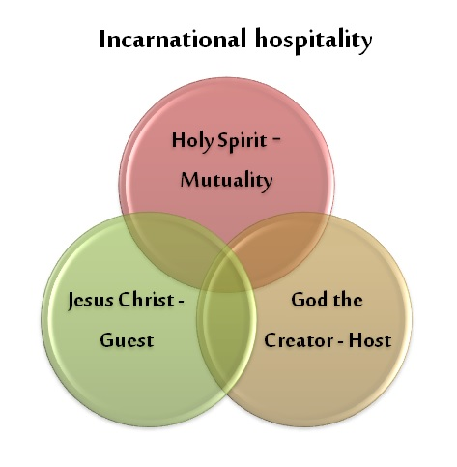
Principles and Practices for Gentleness and Respect (1 Peter 3:15)
Understanding other / self
Kerygma (proclamation)
Winning?
Take initiative
Multi-lingual
Incarnational hospitality

Slide 8
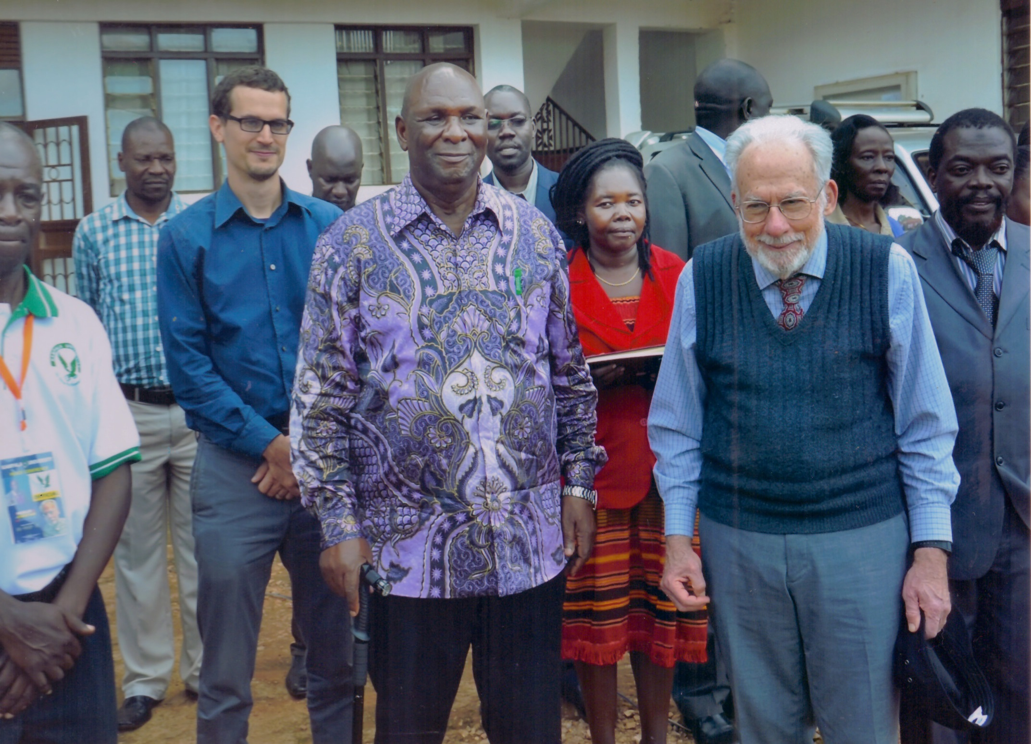

Slide 9
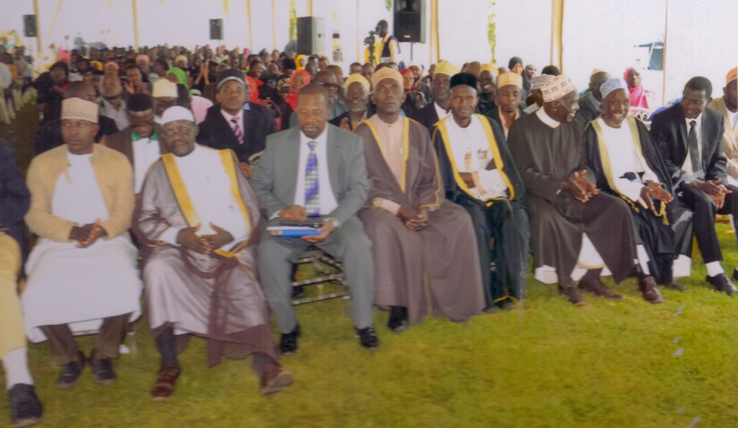

Slide 10
Jesus the Guest
“The Christendom system seriously distorted Christian faith…the price the church paid for coming in from the margins to the center was allowing Jesus to be pushed out from the center to the margins.”
Stuart Murray, The Naked Anabaptist
Stuart Murray, The Naked Anabaptist: The Bare Essentials of a Radical Faith (Herald, 2012), Kindle edition, 52.

Slide 11
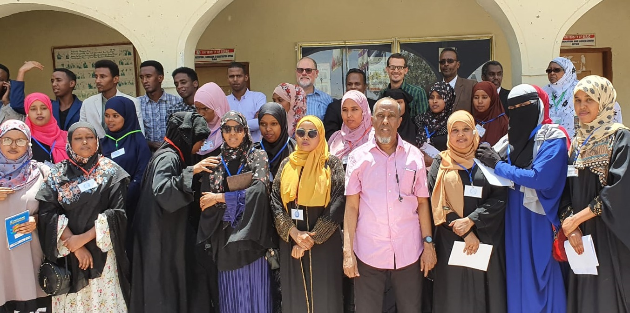
University of Burao, Somaliland

Slide 12
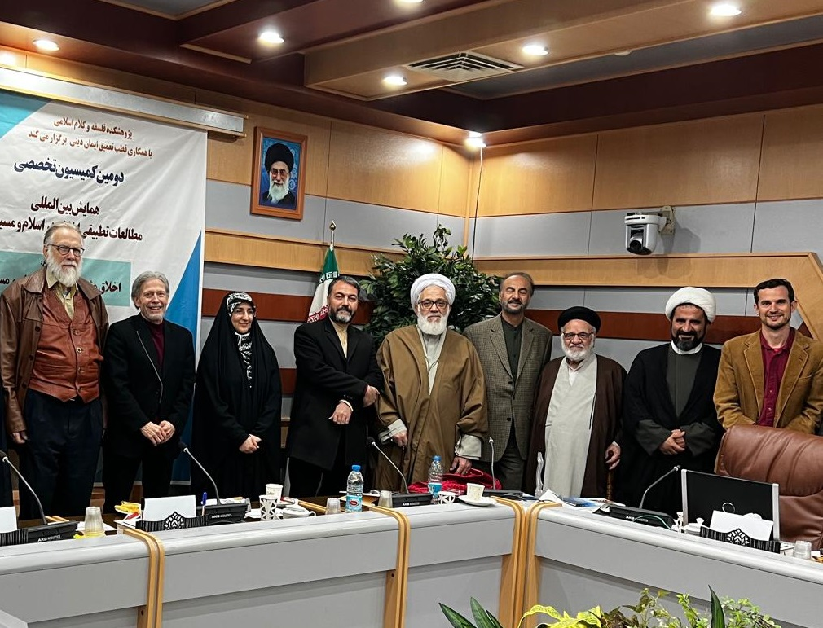

Slide 13
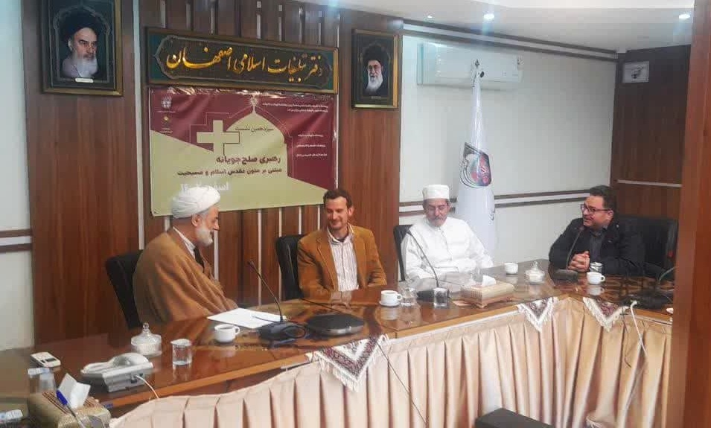

Slide 14
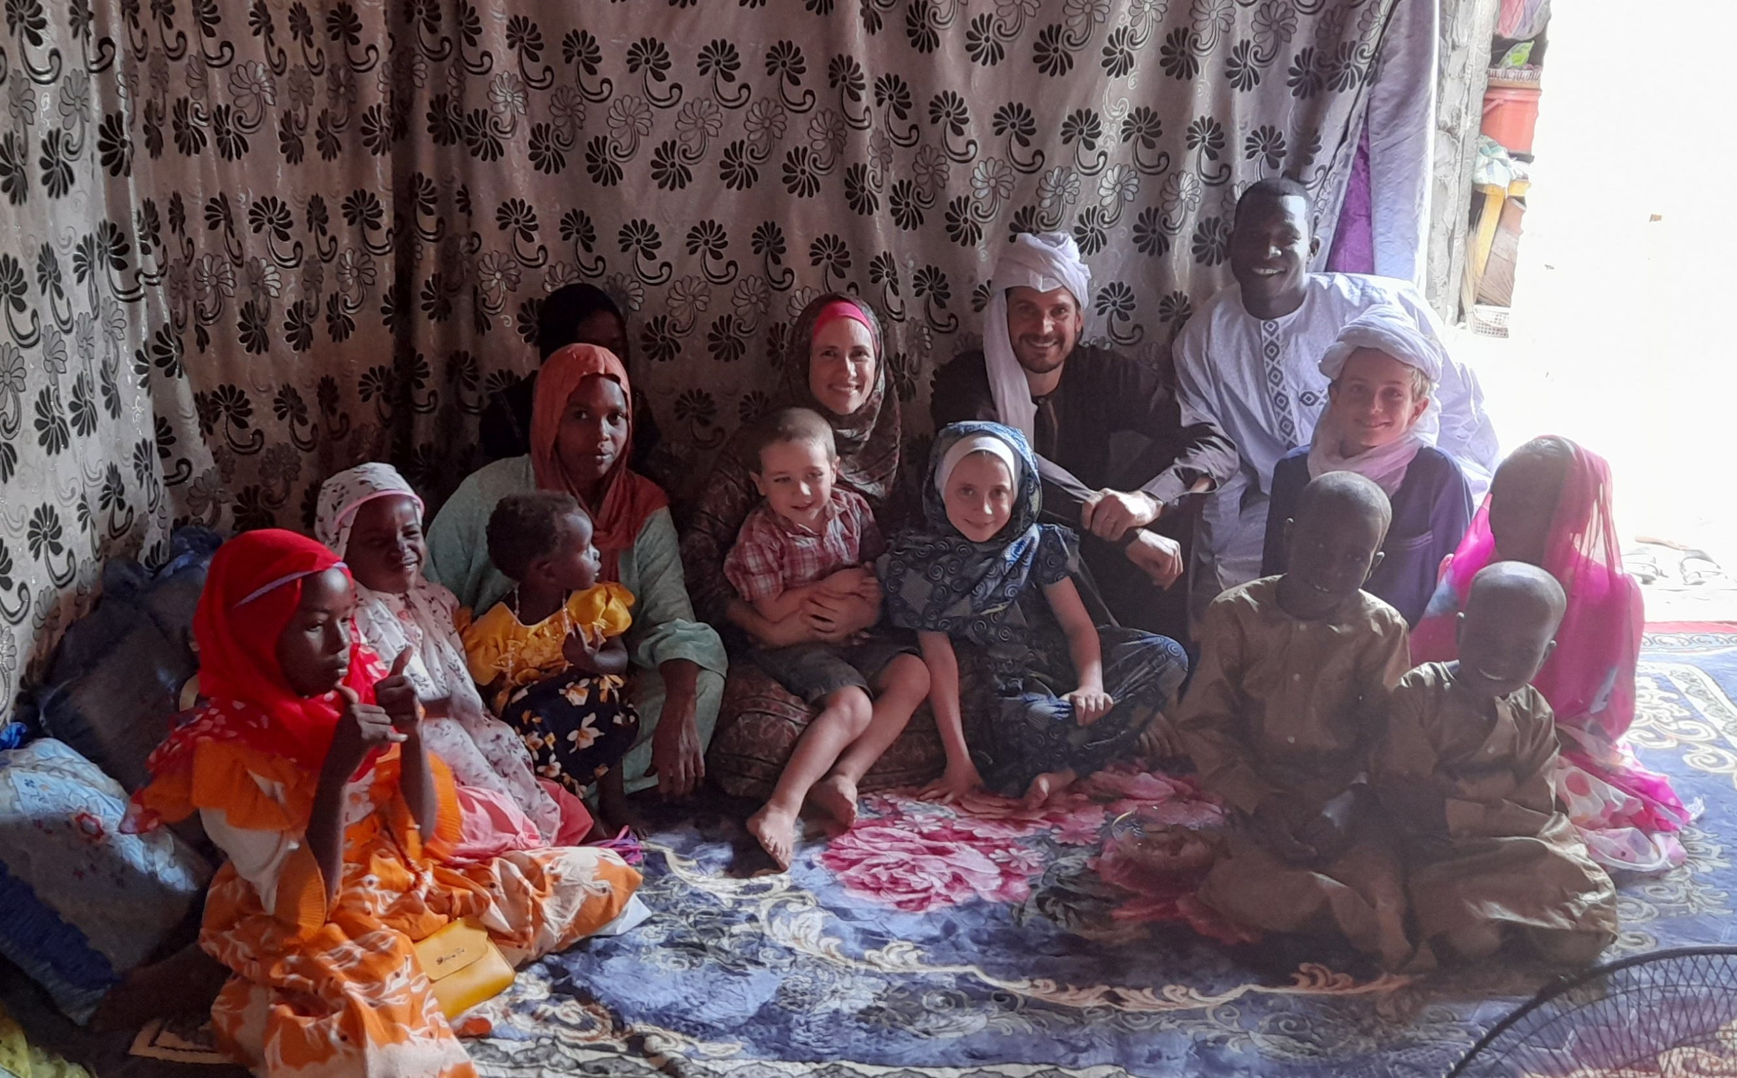

Slide 16
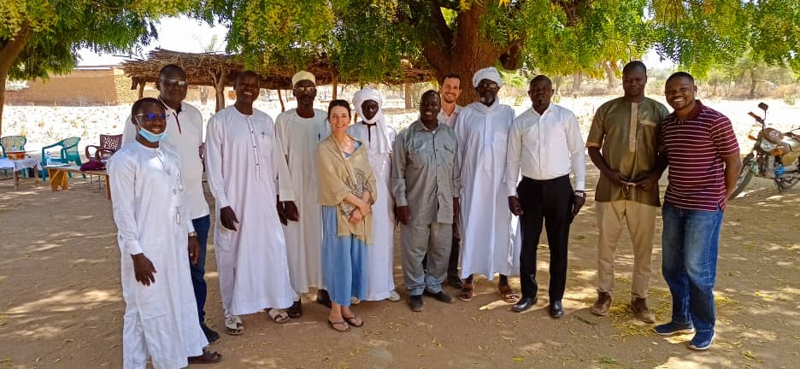
Mutual Partners: Baro Interfaith Committee

Slide 17
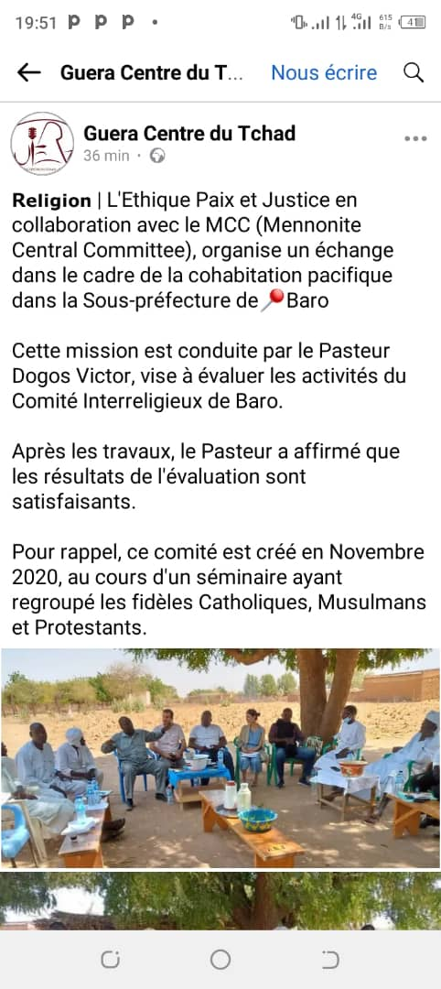
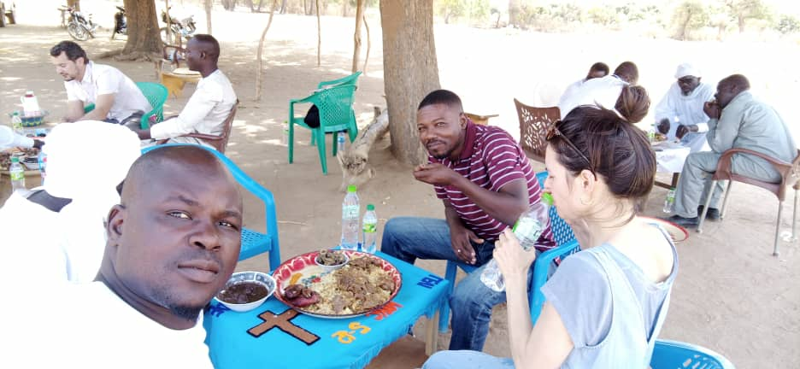
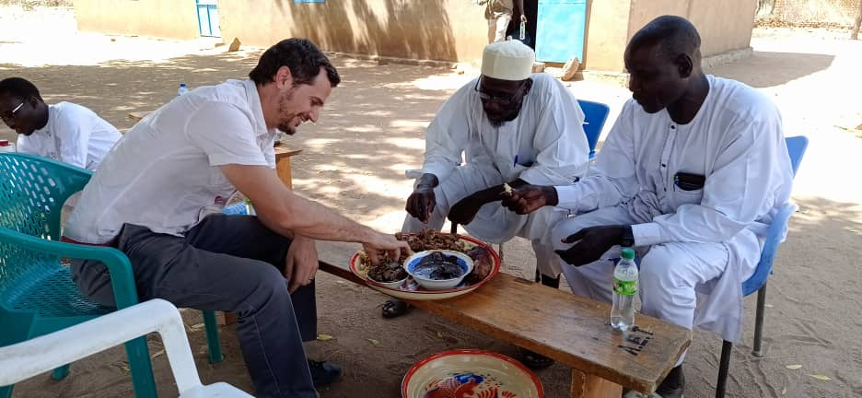

Slide 18
What peace verses do you cite?
“Blessed are the peacemakers, for they will be called children of God.”
Matthew 5:9
“If it is possible, as far as it depends on you, live peaceably with all.”
Romans 12:18

Slide 19
What peace verses do you cite?
“Let there be no compulsion in religion, for the truth stands out clearly from falsehood.”
Surah al-Baqarah (the Cow) 2:256
“To you is your religion (or way), and to me, my religion (or way).”
Surah al-Kafirun (the Disbelievers) 109:6

Slide 20
Where are you or your mission partners in the kind of relationship with Muslims as:
Hosts?
Guests?
Mutual partners?

Slide 21
Resources
Martin Accad, Sacred Misinterpretation: Reaching Across the Christian-Muslim Divide (2019)
Badru Kateregga and David Shenk, A Muslim and a Christian in Dialogue (1997)
Evelyne Reisacher, Joyful Witness in the Muslim World (2016)

